Slide 1
Smart I Advisory Rescue System
SPS - NATO - Slovenia – the former Yugoslav Republic of Macedonia*
Project ISEG.EAP.SFPP 984753
Project duration: 08.04.2015 – 08.04.2018
*Turkey recognises the Republic of Macedonia with its constitutional name.
Notes:
E-mail: contact_siars@finki.ukim.mk
Web-site: http://siars.finki.ukim.mk/

Slide 2
Who we are…
NPD:
University of Ljubljana, Faculty of Electrical Engineering
Ljubljana, Slovenia
Prof. Janez Trontelj, PhD: janez.trontelj1@guest.arnes.si
PPD
Military academy “General Mihailo Apostolski”
Skopje, the former Yugoslav Republic of Macedonia*
Ass. Prof. Jugoslav Ackoski, PhD: jugoslav.ackoski@ugd.edu.mk
*Turkey recognises the Republic of Macedonia with its constitutional name.

Slide 3
Who we are
Co-directors
University Ss. Cyril and Methodius, Faculty of Computer Science and Engineering
Skopje, the former Yugoslav Republic of Macedonia*
Prof. Ana Madevska Bogdanova, PhD: ana.madevska.bogdanova@finki.ukim.mk
University of Ljubljana, Medical faculty
Ljubljana, Slovenia
Prof. Radko Komadina, PhD: radko.komadina@gmail.com
*Turkey recognises the Republic of Macedonia with its constitutional name.

Slide 4
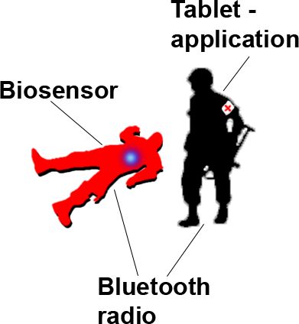
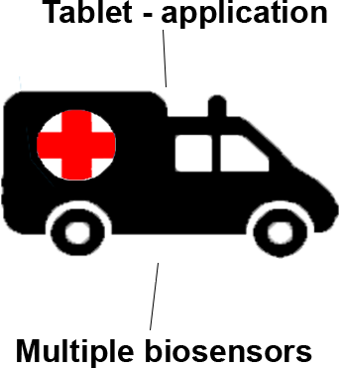
Introduction
Battlefield
SIARS is a Telemedical Information Smart System that uses biosensors, implements an automatic triage for the injured soldiers and transfer their vital parameters to the hospital. First Aid Responder gives medical treatment and prepare the heavy injured soldier for transportation according to the readings from the soldier’s biosensor.
Transport (Role 1)
Multiple biosensors are attached on the injured soldier in order to get more precise clinical picture of the soldier while transporting to the hospital.
Hospital (Role 2)
According the previous measurements, the doctor in the hospital will get the full patient bio data history from the moment of injury.
Notes:
SIARS is a Telemedical Information Smart System that uses biosensors, implements an automatic triage for the injured soldiers and transfer their vital parameters to the hospital. First Aid Responder gives medical treatment and prepare the heavy injured soldier for transportation according to the readings from the soldier’s biosensor.
Multiple biosensors are attached on the injured soldier in order to get more precise clinical picture of the soldier while transporting to the hospital.
According the previous measurements, the doctor in the hospital will get the full patient bio data history from the moment of injury.

Slide 5
Biosensors and radio
Zephyr BioHarness 3
Omnisense - Blood pressure
Nonin - Oxygen saturation
Tait TP9400 radio

Slide 6
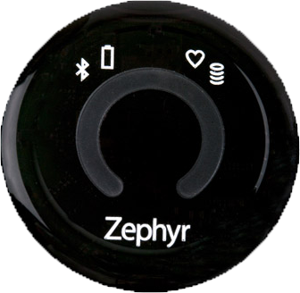
Zephyr BioHarness 3
For extracting ECG, heart rate and respiratory rate, we use the Zephyr Bioharness sensor. The data are streamed at a frequency of 250 Hz.

Slide 7
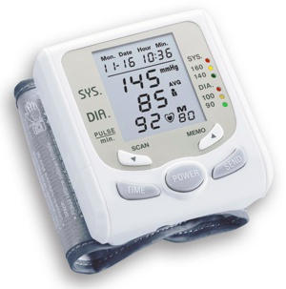
Omnisense - Blood pressure
For measuring blood pressure, we use the automatic MyTech Wrist Cuff Blood Pressure Monitor sensor, which communicates with Zephyr Bioharness bio module by its MAC address.

Slide 8
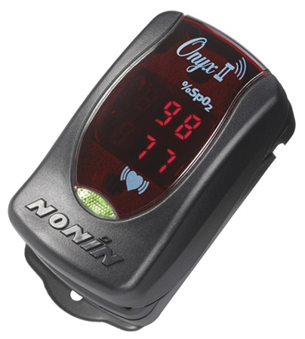
Nonin - Oxygen saturation
For measuring SPO2, we use Nonin Saturated Blood Oxygen device, which also communicates with Zephyr Bioharness bio module by its MAC address.

Slide 9
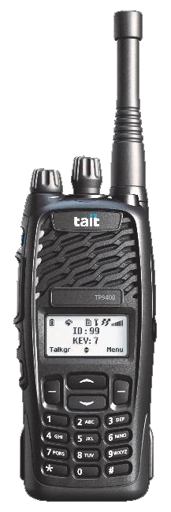
Tait TP9400 radio
For the communication between the biosensors and the FAR’s tablet is used Tait TP9400 radio.
The biosensors send soldiers’ biodata via Bluetooth to his radio, and the radio transfers the data via the FAR’s radio to his tablet, where the application gives the triage information according that biodata. With that information the FAR can decide easily which soldier to treat first.

Slide 10
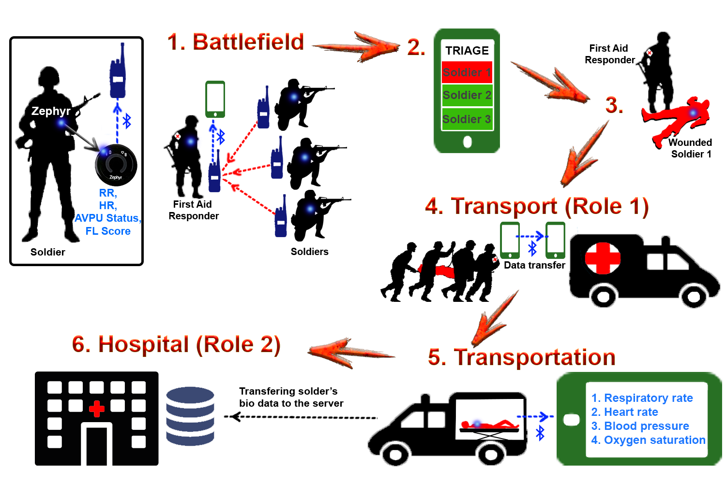
Notes:
SIARS Model

Slide 11
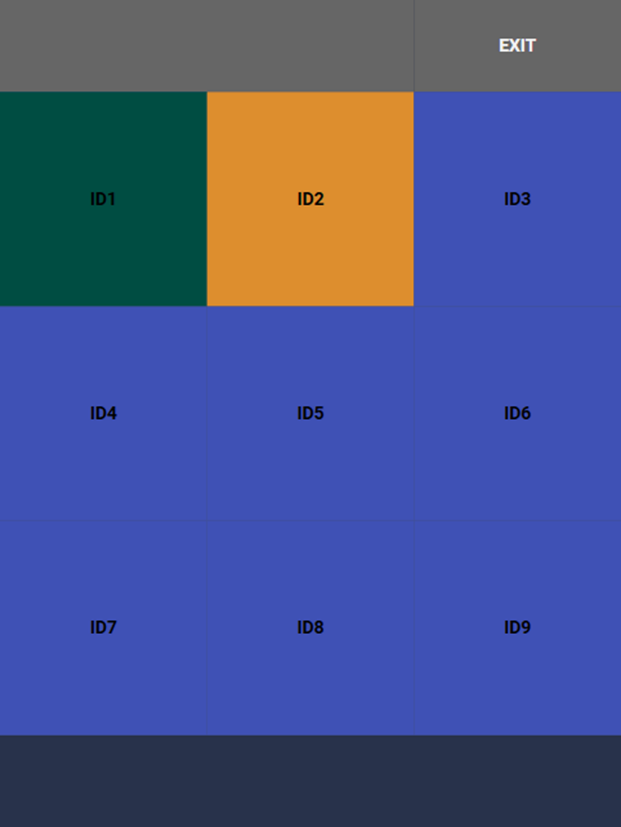
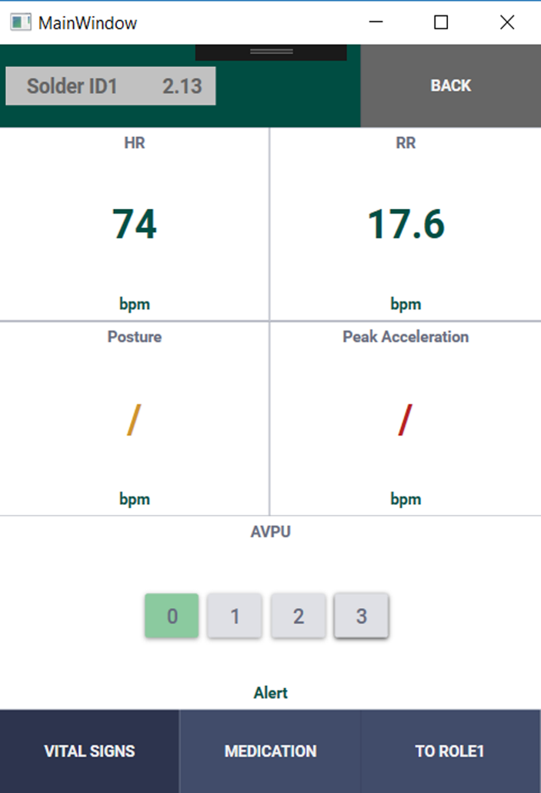
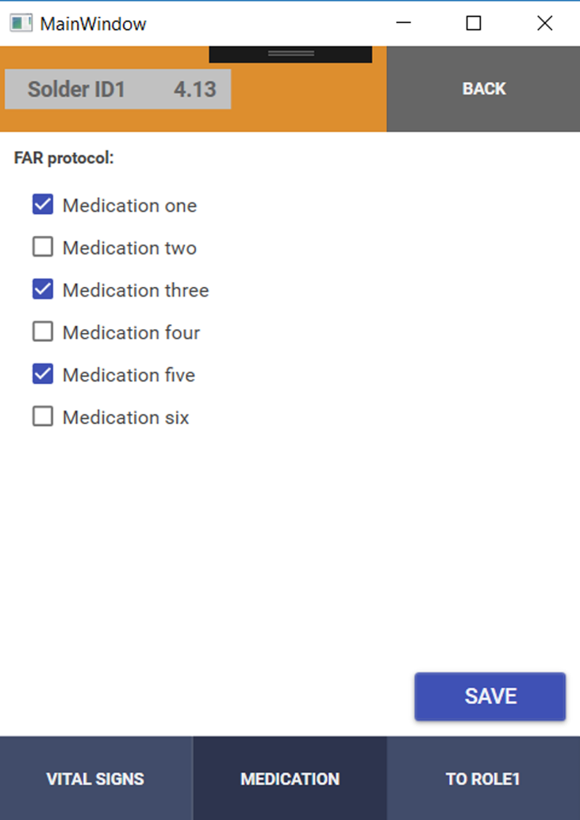
Mobile application for FAR
Notes:
The FAR can see soldiers vital signs and select the given medication

Slide 12
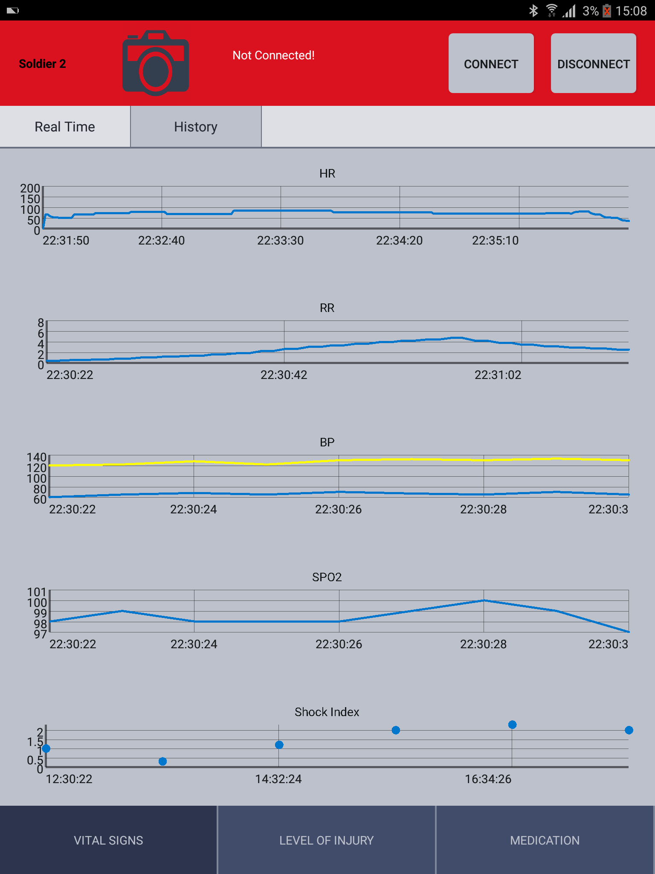
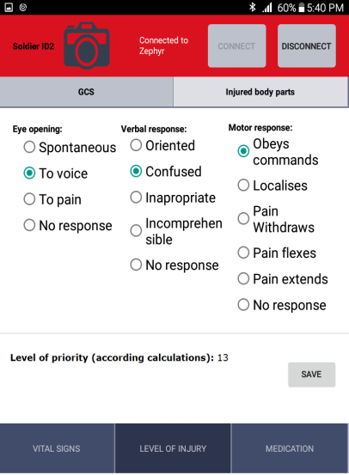
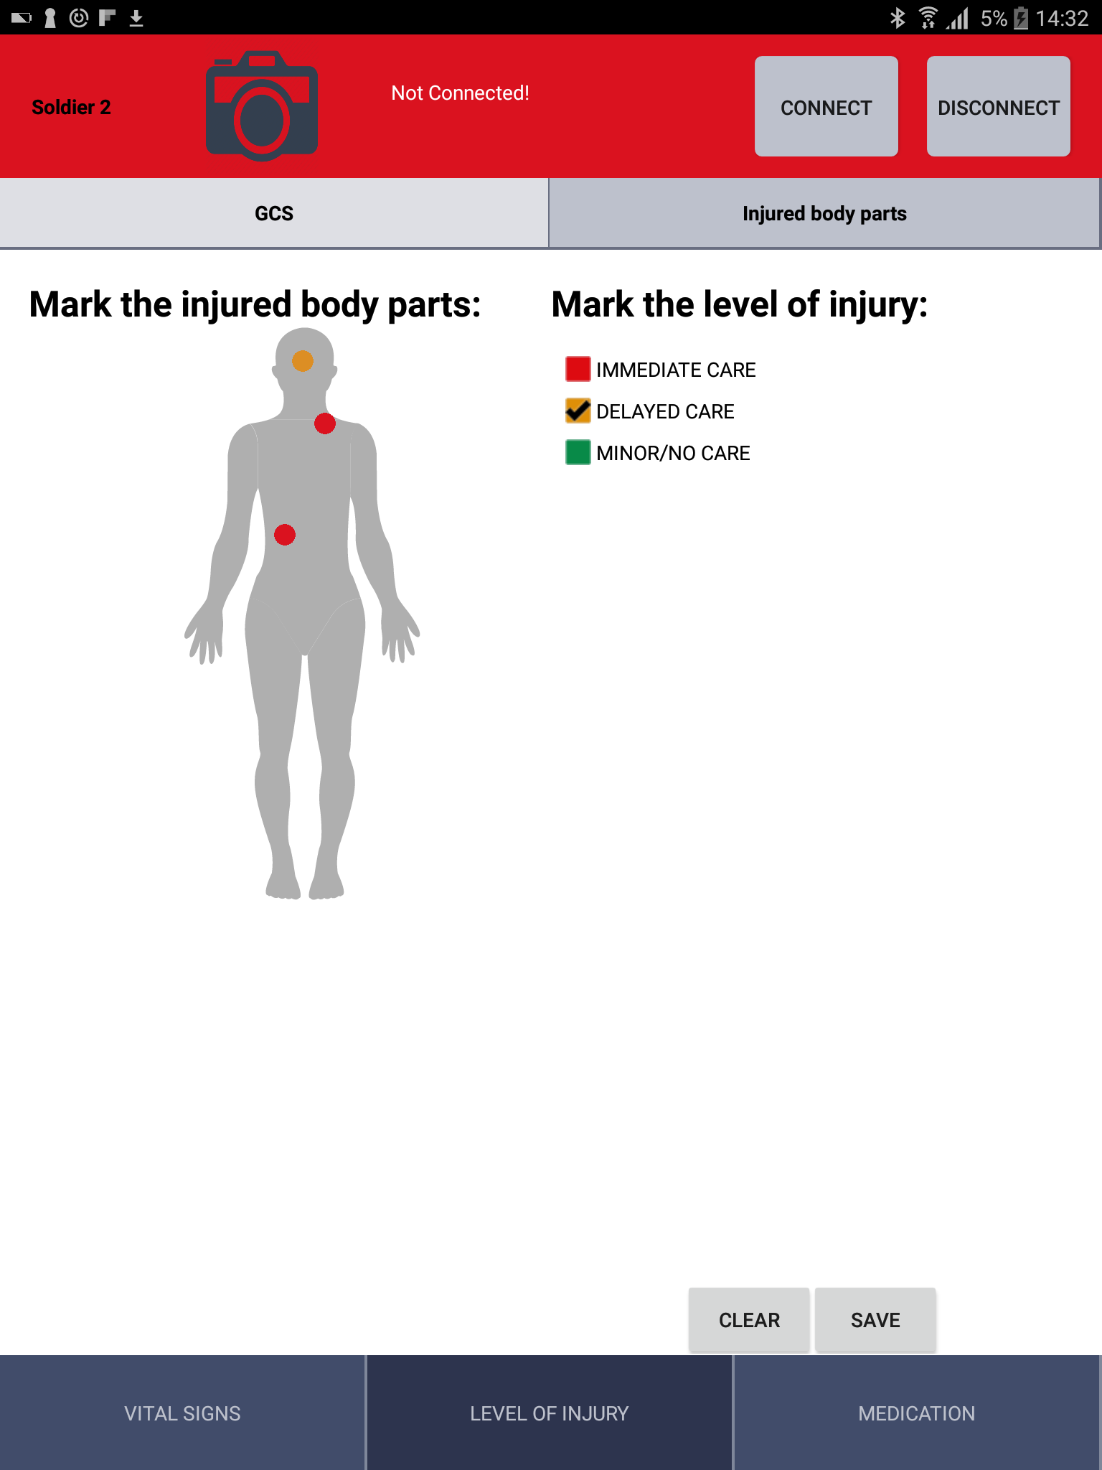
Mobile application for Role 1 (transport)
Notes:
Vital signs screen in real time
History screen for HR and RR
Glasgow coma scale screen
Injured body parts screen

Slide 13
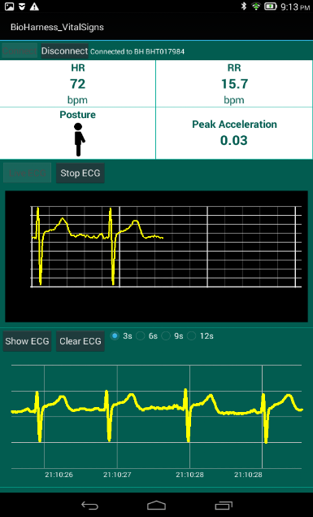
Mobile application for General Hospital in Celje
This application confirms the usefulness of the Zephyr Bioharness sensor in a hospital environment by providing remote monitoring of patient vital parameters. The application is set and tested in General Hospital in Celje, Slovenia.

Slide 14
Benefits
Effective transformation of management in medicine which will be implemented using the Telemedical System;
SIARS will reduce the time of manually collection of vital parameters of injured individual;
Automatic TRIAGE process;
Processing of information to the higher levels of medical care.

Slide 15
More information
www.siars.finki.ukim.mk
www.ma.edu.mk/?page_id=1555&lang=en
Video MA: http://goo.gl/xU7KqQ
Video UKIM: http://goo.gl/Xt235x
www.facebook.com/SiarsNato
www.twitter.com/SiarsNato

